Slide 1
Discord Tournament Bot
Milestone 3 Presentation
Lily Lama-Solet, Shane Wild, Brandynn Daugherty, Grant Richardson, Jonathan Pass

Slide 2
Agenda
Bot classes and methods.
Bot commands and functions.
Project reflection, notable experiences, and challenges.

Slide 3
Bot Classes
Both classes are used for the Matchmake command.
Player
Consists of a players discordID, riotID, rank, tier, and priorities for their roles.
Team
Consists of 5 players, one for each role, top, jungle, mid, bot and support.

Slide 4
Bot Methods
update_points(interaction, player_users, volunteer_users)
Updates participation and games played points.
update_toxicity(interaction, discord_username)
Updates a player’s toxicity points.
update_wins(interaction, winners)
Updates 5 players wins points.

Slide 5
Bot Commands
/checkin
Starts check in, allowing users to check into the next game.
/volunteer
Starts the volunteer check in, allowing users to volunteer themselves out of the next game.
/players
Lists and shows the amount of players and volunteers currently signed up.
/matchmake ‘match number’
Creates fair matches for all players currently checked in.

Slide 6
Bot Commands cont.
/points
Adds the games played and participation for players and participation for volunteers.
/remove
Removes the player and volunteer roles from all users.
/toxicity ‘discordID’
Adds a toxicity point for the player with the discordID on the spreadsheet.
/wins ‘discordID1’ ‘discordID2’ ‘discordID3’ ‘discordID4’ ‘discordID5’
Adds a win to the player with the discordID to the spreadsheet.

Slide 7
Notable Experiences and Challenges
Adding players to the sheet proved to be very challenging; could not be implemented, thus the Riot API was unused.
Python was a very limiting language and has issues with google api requests and package functionality.
Due to the challenges, we were unable to look into developing access for running tournaments for other comp games.

Slide 8
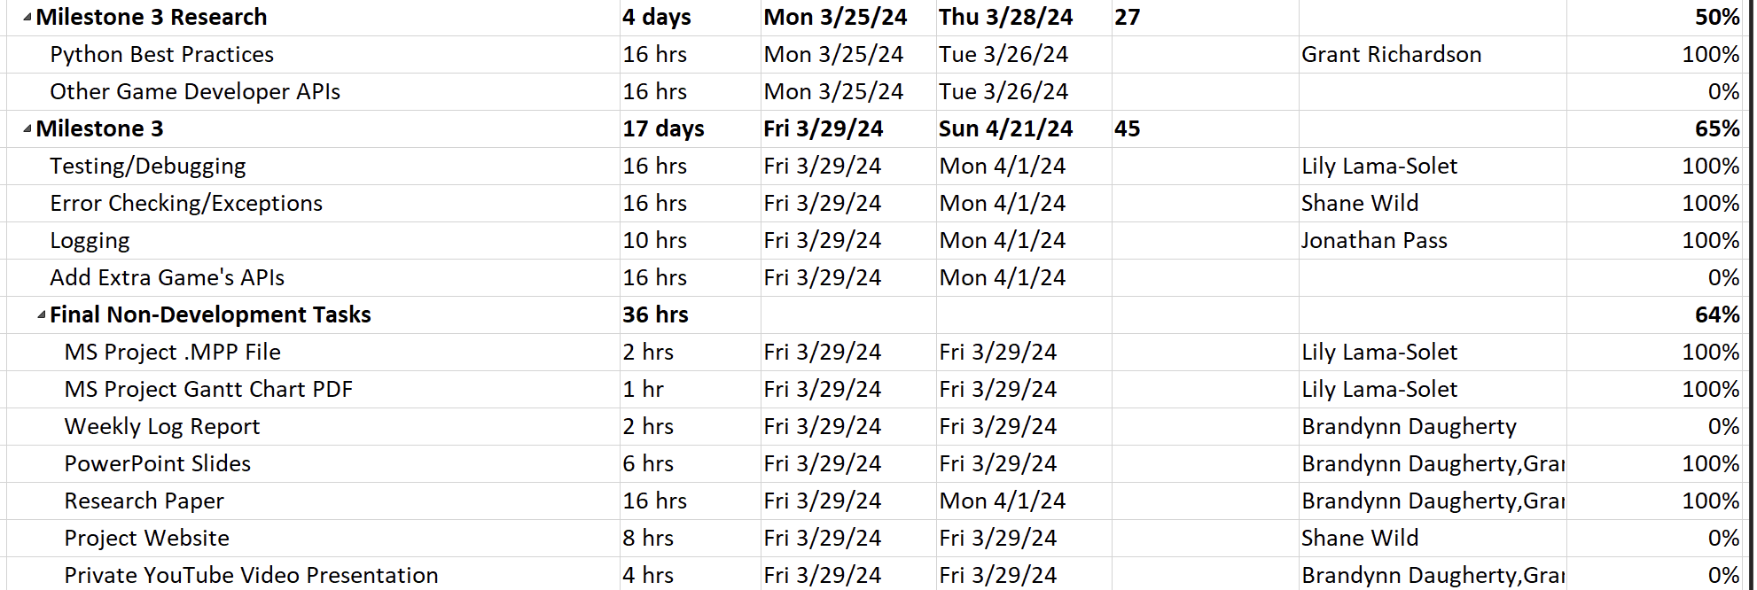
Gantt Chart

Slide 9
Member Contributions
Lily Lama-Solet
Worked on bot slash commands ideas and implementation.
Worked on debugging issues.
Shane Wild and Brandynn Daugherty
Worked on bot slash commands and respective methods for writing to Google Sheets.
Troubleshooted bot commands/methods.
Grant Richardson
Worked on research paper and presentation.
Jonathan Pass
Worked on /mvp command for bot.

Slide 10
Bot Demo

